Slide 1
Financial Outlook: 2018 Report for Higher Education

Slide 2
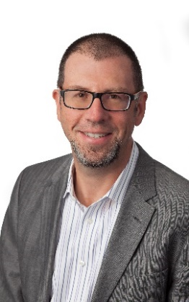
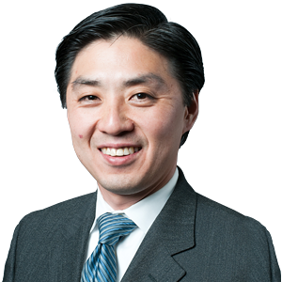
MEET YOUR PRESENTERS
Charles Kim,
Managing Director
Kaufman Hall
ckim@kaufmanhall.com
Tony Ard
VP of Higher Education Software
Kaufman Hall
tonyard@kaufmanhall.com

Slide 3
Market Dynamics in Higher Education
Survey Results
Strategies for the Future
About Kaufman Hall
Q&A

Slide 4
MARKET DYNAMICS
Notes:
Charles

Slide 5



Significant Challenges Facing Institutions in 2018
Funding sources at risk
Growing expenses
Increased competition

Slide 6
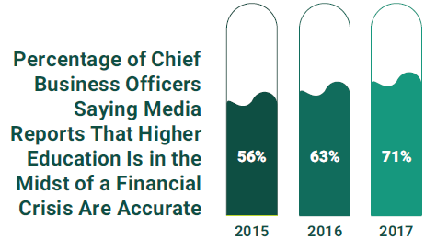

Turmoil in Higher Education
Over half (57%) of board members agree or strongly agree that general public perception of higher education in the U.S. has declined in the last 10 years.
SOURCE: THE 2017 INSIDE HIGHER ED SURVEY
OF COLLEGE AND UNIVERSITY BUSINESS OFFICERS
A study by Gallup and Inside Higher Ed
SOURCE: The AGB 2017 Trustee Index

Slide 7
2018 Kaufman Hall Survey of Higher Education Professionals
Notes:
Tony

Slide 8
About the Survey
Institution Type
ROLES
5%
For-profit college or university
21%
Two-year non-profit college (community college)
32%
Four-year non-profit private college
42%
Four-year public
college or university

Slide 9
About the Survey
ENROLLMENT
ENDOWMENT
21%
Greater than 20,000
6%
Greater than $1B
16%
$500M-$1B
47%
Less than
5,000
57%
Less than
$100M
21%
10,000-20,000
21%
$100M-$500M
14%
5,000-10,000

Slide 10
Increasing Revenue and Reducing Expenses Are Top Institutional Goals
believe their current business model is not sustainable
47%
Goals your institutions plans for current year
  Increase revenue
  Decrease costs
Notes:
Something about demographics trends don’t support everyone growing revenue. Comment on data sliced by institution type

Slide 11
Integrated Planning and Budgeting are Top 2018 Finance Initiatives
Top financial planning and analysis initiatives for 2018
  ● Budgeting ● Reporting ● Long-range planning
Which of the following financial planning and analysis initiatives are your institution looking to improve in the coming academic year?

Slide 12
Modern Practices and Tools Enhance Agility in a Changing Environment
64%
66%
Acknowledge higher education is behind most other industries in terms of adopting modern financial planning practices
and tools
Say they are not prepared to respond quickly to change,
or were unsure if they could use existing tools and processes to do so

Slide 13

Planning Must Be a Disciplined, Integrated, and Institution-Wide Activity
of institutions do not use a long-range plan
14%
PRIMARY GOAL OF LONG-RANGE PLAN
54%
30%
alignment with strategic plan
capital planning and allocation
© 2017 Kaufman, Hall & Associates, LLC. All rights reserved.

Slide 14
Better Data Are Required to Support Better Decision Making
87%
say that more insightful data into their institution’s performance would result in better financial decisions

Slide 15
More Timely Budgets Are Needed to Support Institutional Planning
43%
said current length of budget cycle limits ability to make informed decisions and react to changing circumstances
From initial rollout to board presentation, how long is your budget cycle?

Slide 16
Budgeting and Forecasting Processes Lag Other Industries
62%
said budgets are GAAP-based and consistent with financial statements
How frequently in your institution doing an in-year forecast?

Slide 17
Capital Planning Responsibility is Dispersed
Which department is primarily responsible for the capital planning process at your institution?

Slide 18
Strategies for the Future
Notes:
Charles

Slide 19
Assume a Strategic Leadership Role
Analyst
Strategic Partner
Forward Thinking
Measuring
Planning
Calculating
Modeling
Past and future
Advising
Growth focused
Risk aware
Present & future
Connected
Quadrant 4
Embodies all the characteristics of the other three quadrants plus leadership and outbound activities
3
4
1
2
Scorekeeper
Controller
Reporting
Accuracy
Retrospective
Disconnected
Gatekeeper
Expense focused
Governance
Retrospective
Level of Responsibility

Slide 20
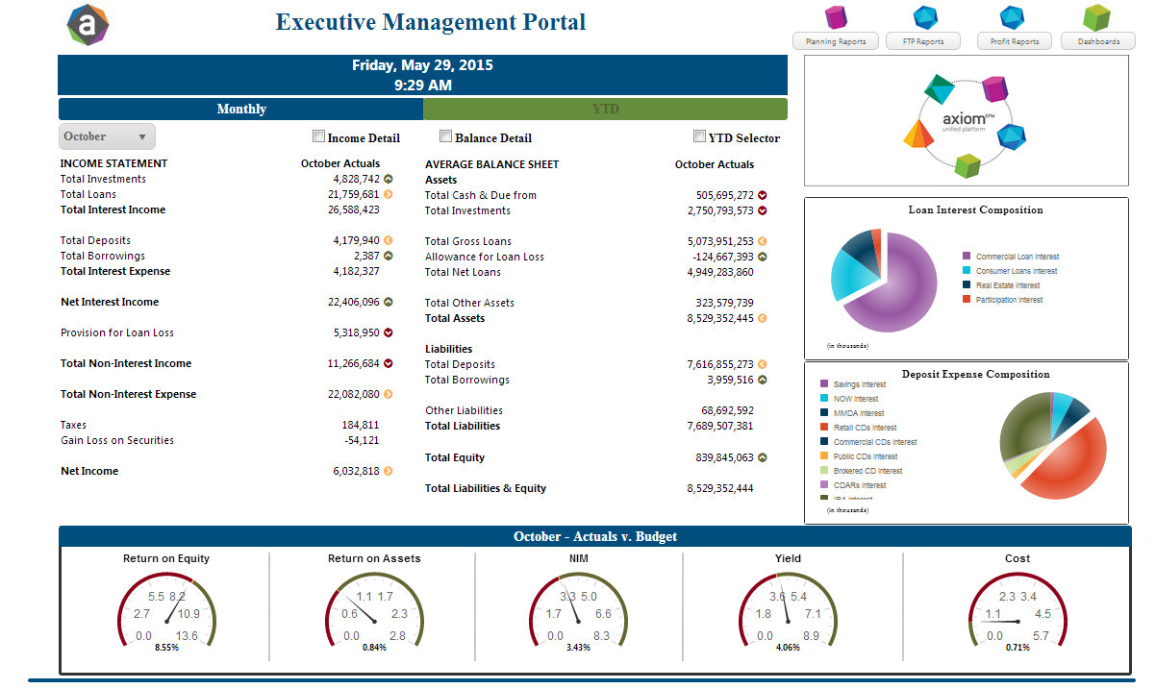
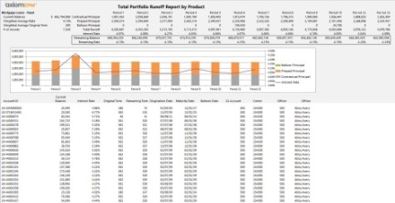
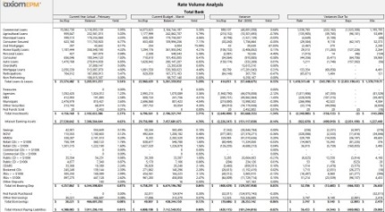
Ensure Access to Relevant and Timely Data
Mobile, Dashboards
Higher Level KPI’s and Dashboards
“C” Level
Dashboards, Reports, Interactive
(direct access and distributed)
Consolidated Results, Outliers,
& Explanations
Managers
Reports; Interactive
(direct access)
Detailed Reporting & Drill Thru Analysis
Finance
Real-time access
Specific Data & Analytics to support real-time decisions
Front-line

Slide 21
Conduct Disciplined Financial and Capital Planning
$X
Over-Investment
The Corridor of Control is the balancing point between two opposing goals:
  1. Compete effectively through aggressive investment of capital and operating dollars, BUT
  2. Respect the fiduciary role of management and the board to maintain the long-term financial integrity of a community asset
Corridor of Control
Strategic Investment
Under-Investment
$0
$X
Capital Capacity

Slide 22
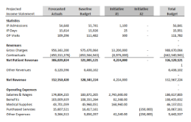
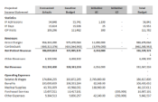
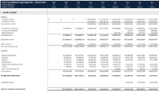
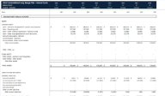
Create a Multi-Year Financial Plan
Forecasting methods include:
Base Case
Given current trends, what is our financial outlook 5-10 years?
Statistically-driven modeling
Enrollment and tuition forecasting
Expense growth
Non-tuition revenues
Capital expenditures
Debt
Base Case
(Conservative)
Examples:
Initiatives
As we prioritize growth or cost containment initiatives, what is the incremental impact?
Online offering
Satellite campus
New residence hall
Faculty recruitment
New research building
Athletic investments
International expansion
New instructional facilities
Initiative #1
Initiative #2
Initiative #3
Initiative #4
Scenarios
What is the impact on our baseline projections given the initiatives we’ve proposed?
Analysis contains:
Income Statement
Balance Sheet
Cash Flow
Key Ratios
Consolidated Results
Notes:
NIck

Slide 23

Achieve Faster and More Strategic Budgeting
The operational budget is a part of a strategic decision making framework
The operational budget flows from the long range plan
  The long range plan sets operational targets
  The operating budget assigns resources and accountability
A best practice operational budget process engages the organization which leads to institutional buy-in to financial plans

Slide 24
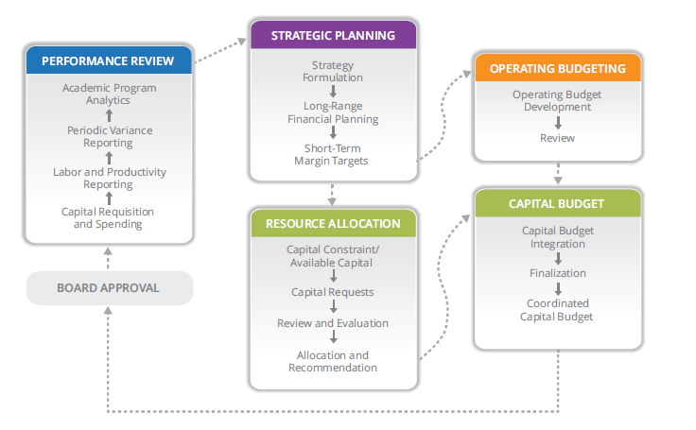
Adapt an Integrated Planning Framework

Slide 25

KAUFMAN HALL:
YOUR PERFORMANCE
MANAGEMENT PARTNER

Slide 26

Guiding strategy and enabling outcomes with comprehensive and integrated financial consulting
and performance management software tools.
30
#1
400+
Years
Customer Satisfaction
Professionals
Helping senior leaders realize success amid changing market
Top financial advisor and #1 rated software platform by Gartner
in offices throughout
the United States

Slide 27





OUR INTEGRATED ADVISORY SERVICES
Process Design
Treasury Management
Budget Model
Design
Financial Planning
& Analytics

Slide 28




AXIOM SOFTWARE SOLUTIONS
Strategic Financial
Planning
Reporting &
Analytics
Budgeting &
Forecasting
Long-Range Planning
Executive Dashboards
Budgeting & Forecasting
Capital Planning & Tracking
Financial Reporting
Grants Planning
Tuition Planning
Ad Hoc Reporting
Allocations
Align financial plans with strategic goals, manage capital initiatives, and communicate key financial metrics and ratios to leadership.
An integrated solution for developing management reports and performing ad hoc analysis.
Engage academic and administrative leaders in budget formulation to align resources and manage financial performance.
© 2017 Kaufman, Hall & Associates, LLC. All rights reserved.

Slide 29




YOUR PARTNER FOR OPTIMIZED PERFORMANCE IN HIGHER EDUCATION
Experienced Team
Modern Software
Unparalleled Service
With 200+ years in combined Higher Education experience, our experts leverage proven best practices to help you optimize financial and operational performance.
Transform long-range planning, operational budgets, data analysis and performance reporting with a modern cloud-based software platform trusted by over 200,000 users.
Work with the team rated #1 for customer satisfaction by Gartner. Our consulting, software implementation and technical support teams work tirelessly to ensure your success.
© 2017 Kaufman, Hall & Associates, LLC. All rights reserved.

Slide 30
QUESTIONS & ANSWERS
Charles Kim,
Managing Director
Kaufman Hall
ckim@kaufmanhall.com
Tony Ard
VP of Higher Education Software
Kaufman Hall
tonyard@kaufmanhall.com

